Slide 1


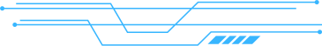

WHISPER WALLS

Slide 2


OVERVIEW
The "Whisper Walls" project aims to use technology to combat loneliness and build community in the real world. The core idea is to create a mobile application that allows people to leave anonymous, hidden messages, or "Whispers," in real-world locations for others to find. The app works by showing you a map of nearby "Whispers". When you get close to a location, you receive a notification, and by opening your camera, you can see the hidden message appear on your screen using augmented reality. Users can also leave their own anonymous message for others to discover. The goal is to create a personal and universally connective experience that is a direct response to the impersonal nature of digital communication.
The technical approach for this project involves building a mobile app using
1. React Native for the front end and Google Firebase for the backend. The AR functionality will be powered by a library like
2. ViroReact. The project prioritizes a safe and positive platform, using a community-based flagging system to hide inappropriate content.

Slide 3


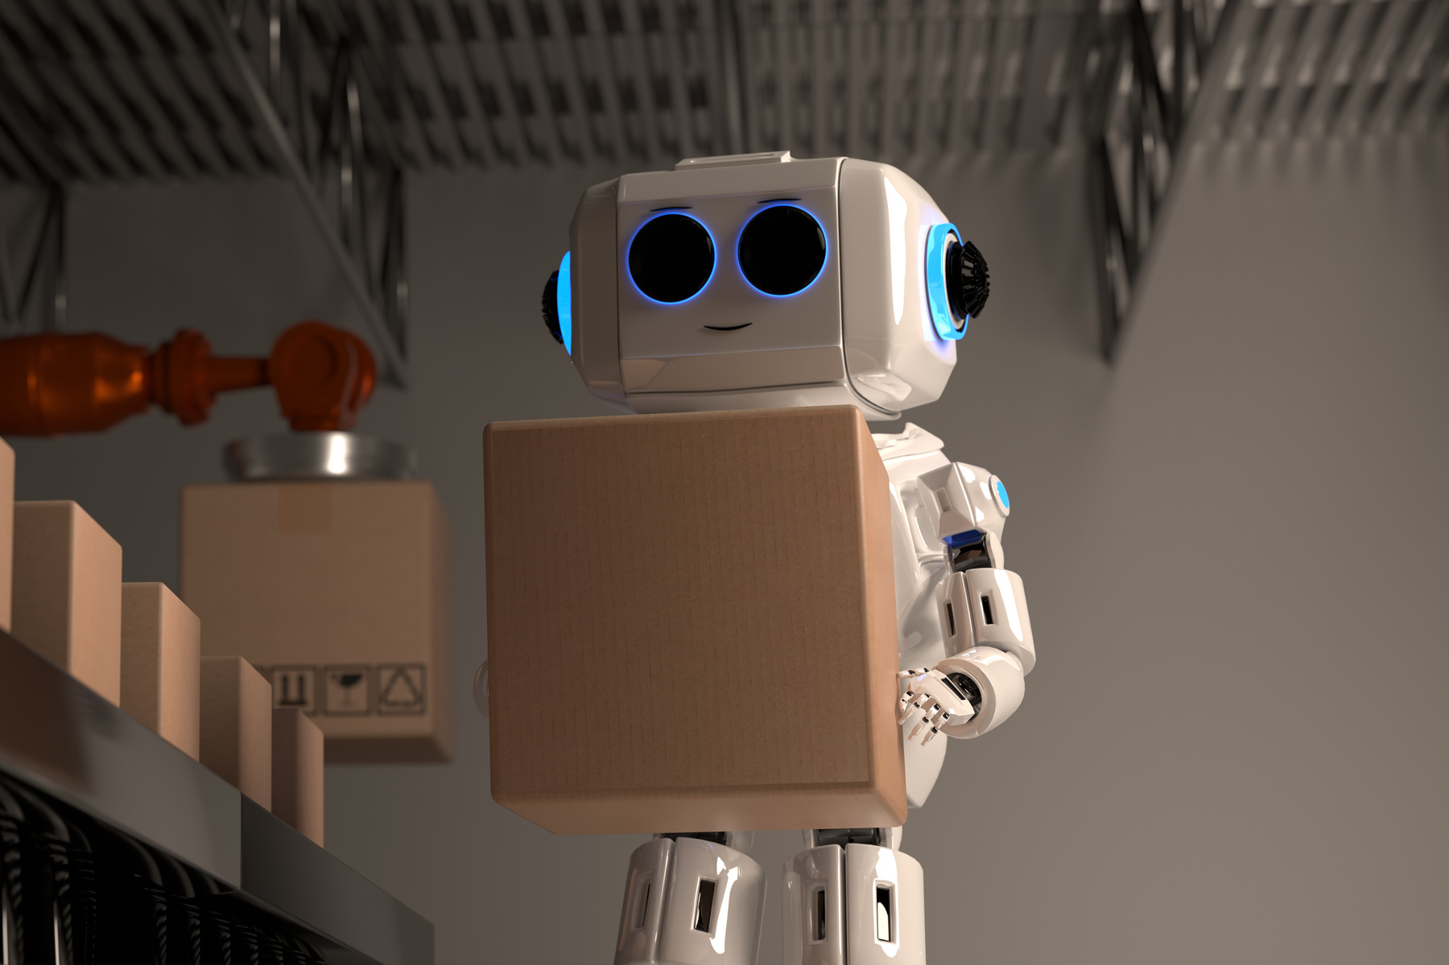
ABOUT US
OUR TEAM
1.SHUBHAM DUDHBHATE (VJTI, B-TECH in IT)
2.Ayaan Mirza (VJTI ,B-tech in CE)
3.Shreyansh Mojidra (VJTI, B-tech in CE)
4. Aryan Patil (SIGCE, B.E in CE)

Slide 4
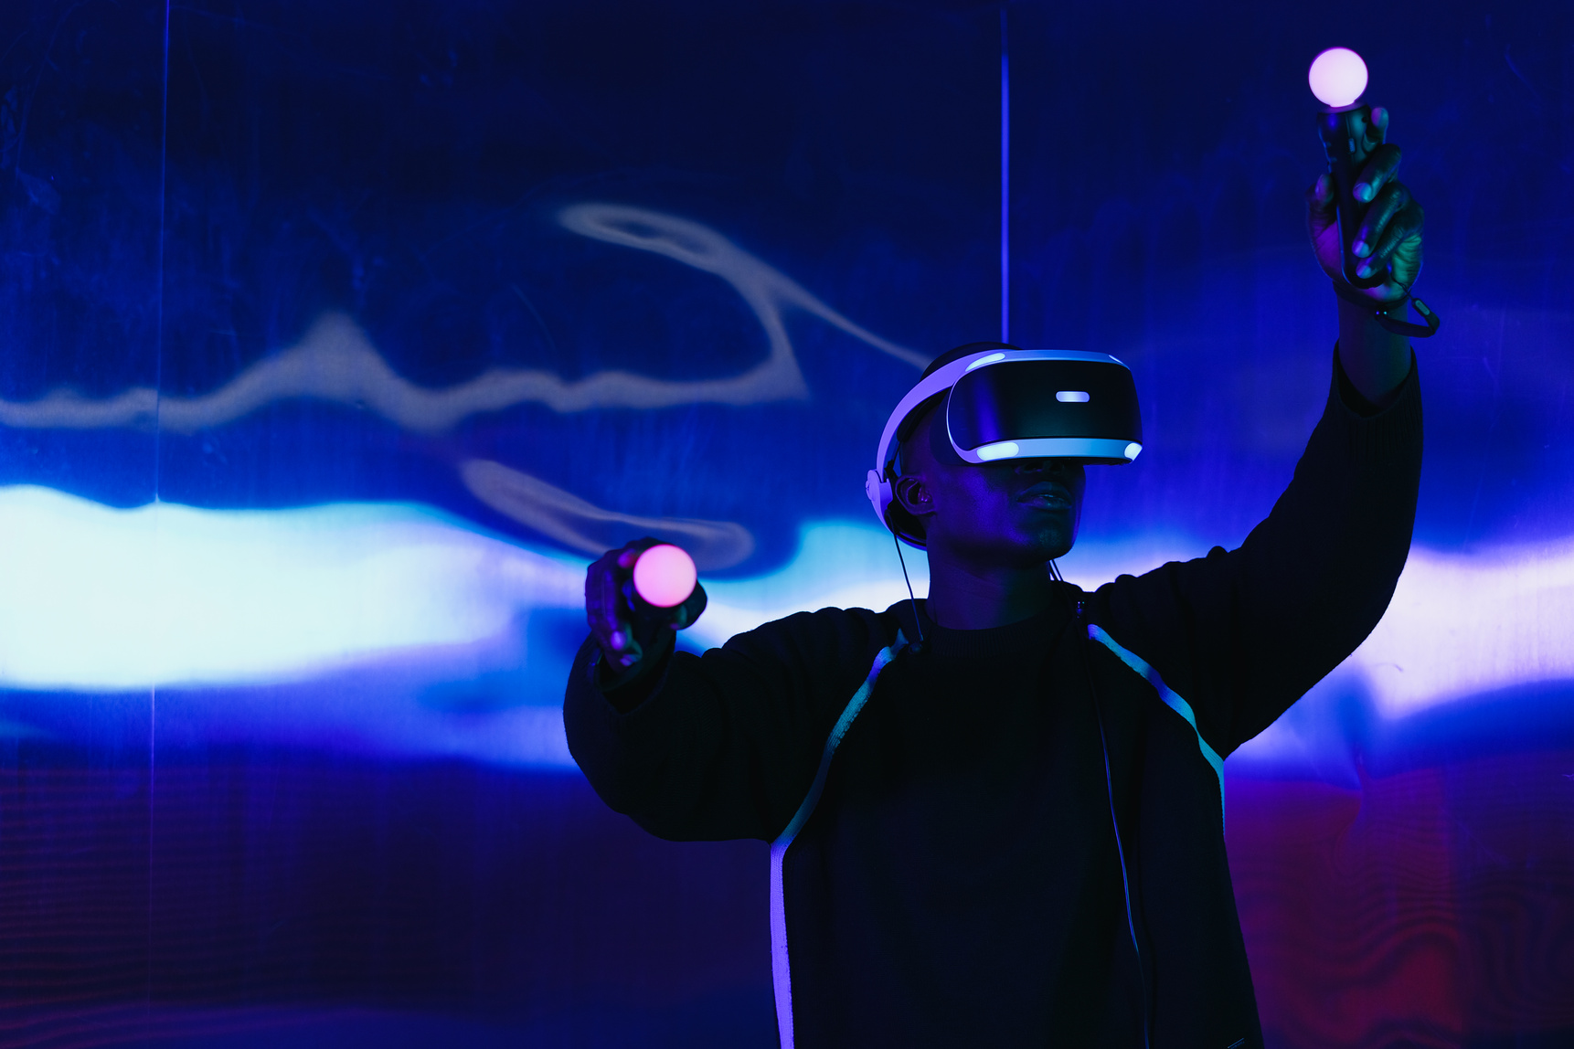
VISION
The vision for this project is to use technology to re-enchant the world and foster a sense of real-world connection. The team wants to give people a reason to look up from their screens and see their surroundings as a place filled with stories and emotions. The goal is to create moments of unexpected joy and reflection when someone finds a message from a stranger, helping them feel connected to that specific location.
Blending Form and Function: Providing a platform for positive, anonymous, and heartfelt expression. This gives users a safe space to share their thoughts and creativity without the pressure of typical social media.
Empowering Design Freedom: The product is seen as a way to create an experience that is both deeply personal and universally connective. It aims to provide a positive outlet for self-expression focused on kindness, creativity, and positivity.

Slide 5

CONTENTS
sr no . | Topics
1 | Why we selected this topic Aim
2 | Approach to achieve that
3 | Aim behind choosing this topic
4 | Target Audience
5 | Benefits to Users
6 | Image Idea of Creating

Slide 6
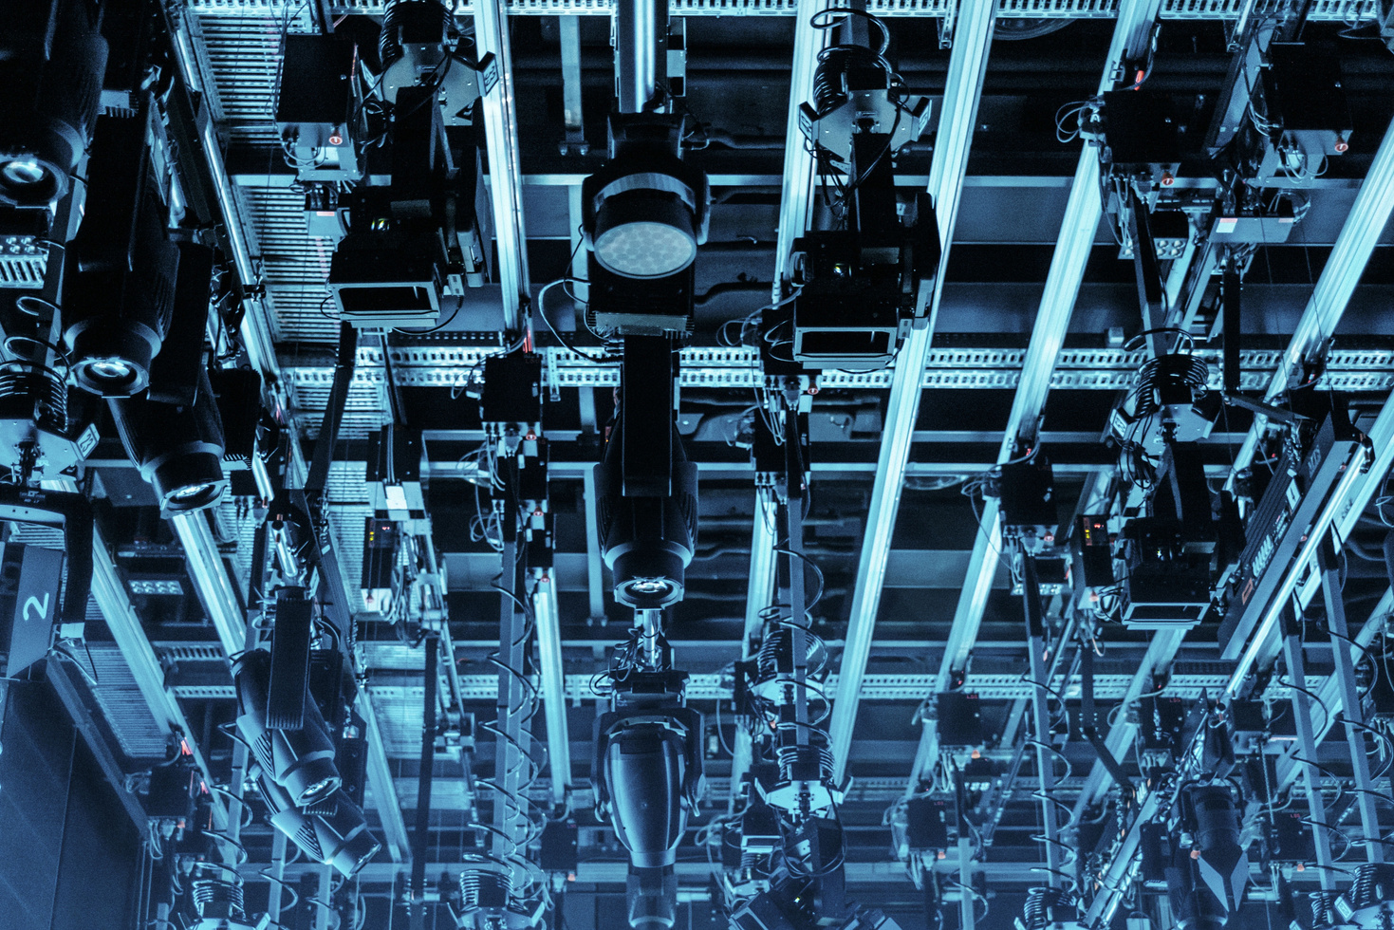

Why we Selecting this Topic ?
The Problem: We're more connected online than ever, but we've lost our connection to the physical world around us. We're on our phones instead of talking to the person next to us or noticing the history of our own neighborhoods.
Our Belief: There's a fundamental human need for meaningful, local connections. We want to bring back the wonder of stumbling upon something unexpected in a specific place.
The Solution: We're creating a way for people to leave a piece of themselves—a hidden message or a personal story—for others to find in a real-world location.
The Goal: This project is a direct response to the impersonal nature of digital communication. It's about creating an experience that's both deeply personal and universally connective.

Slide 7



ApproacH TO ACHIEVE THAT
We'll build a user-friendly and reliable mobile app. We're using React Native
for the app itself and Google Firebase for the backend, which helps us scale
easily. The "magic" of our experience will come from Augmented Reality (AR),
using a library like ViroReact to bring messages to life.
How it Works (User Experience)
Discover: The app shows you a map of nearby places where there are hidden massages or “ Whispers”
Engage: When you get close to a location, you'll get a notification.
3. Experience: You open your camera, and the hidden message appears on
your screen as if it's right there in front of you.
4. Create: You can then leave your own anonymous message for someone
else to find later.
Roboto
Roboto

Slide 8
TARGET AUDIANCE
Young Adults & Students (16–28 years) People who are active online, love trying new things, and are open to fresh ways of connecting with others.
Urban Explorers & Creatives Artists, writers, photographers, and anyone who enjoys exploring their city and finding hidden gems.
Tourists & Travelers Visitors who want genuine, heartfelt recommendations from locals instead of the usual tourist spots.
Roboto
Roboto

Slide 9
Aim BEHIND CHOOSING THIS TOPIC
Our main goal is to use technology to fight loneliness and create a sense ofcommunity in the real world. We want to build a platform for positive,anonymous, and heartfelt expression.
Re-enchant the World: We want to give people a reason to look up
from their screens and see their everyday surroundings as a place full
of hidden stories and emotions.
Foster Serendipitous Connection: We aim to create moments of
unexpected joy and reflection when someone finds a message left by
a stranger, realizing they share a connection to that specific spot.
Provide a Positive Outlet: We're offering a space for anonymous self-
expression focused on kindness, creativity, and positivity, without the
usual pressures of social media.
Roboto
Roboto
COMMUNITY AND SAFETY
While anonymity is a key feature, we also prioritize safety. We'll have a
simple, community-based flagging system that allows users to report
inappropriate content, whichwill be automatically hidden

Slide 10
WHAT WILL BE THE BENEFIT TO USERS?
Why Use Whisper Walls?
A Little Surprise in Your Day
Stumble upon something beautiful or unexpected that brightens an ordinary moment.
A Safe Space for Expression
Share your thoughts and creativity freely, without pressure or judgment.
See Places Differently
Discover hidden stories that add new meaning to familiar streets,
walls, or corners of your city.
Feel Connected
Reading a stranger’s message reminds you that we’re all part of the
same shared human experience.
Roboto
Roboto

Slide 11
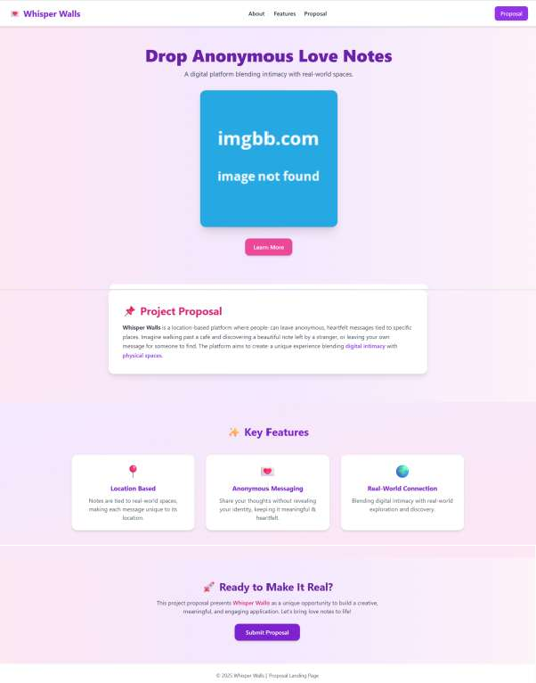
A BASIC IMAGE IDEA THAT WE WILL BE CREATING
This will be subjected to more advanced scenarious will be carried out
further after selections.Mentioing it here these is going to be something
really special for the hackathon and also for us as it is the most exciting
project idea that we are going to deal it with.

Slide 12
Anonymous but positive platform
Most anonymous apps (like YikYak, Whisper) became toxic. Whisper Walls focuses on kindness, creativity, and reflection, ensuring a safe outlet with moderation.
A simple, hackathon-feasible tech stack (React Native + Firebase + AR library) is being used in a highly creative way that hasn’t been mainstreamed yet.

Slide 13
THANK YOU

